Slide 1
NYC Crime 2025
By: Misael Perez, Syed Kauser, Md Omit

Slide 2
Project
For this project, we are trying to learn when, where , and who are committing crimes New York City (NYC) in the year 2025. We are trying to discover pattern/relationships that exist in the demographics, crime type, borough, and income. To accomplish this, we looked at two datasets that show crimes that happen in the five boroughs with their zip codes, and the household incomes in the five boroughs.

Slide 3
Datasets for Graphs
NYC OpenData
It is a public online portal that offers NYC government data for free
Link: https://data.cityofnewyork.us/Public-Safety/NYPD-Complaint-Data-Current-Year-To-Date-/5uac-w243/about_data
Rowzero
It is a cloud-based spreadsheet that offers U.S income based on zip code
Link: https://rowzero.com/datasets/income-by-zip-code?utm_source=chatgpt.com

Slide 4
Dataset Information
Our data contains historical data as it contains criminal incidents that were recorded in 2025 by the NYC Police Department. The dataset provides information about when, where, and how each crime happen. As well as the suspect, victim, and crime type.
It had over 250,000 crime records and 40 attributes (Before)
Categorical and numerical data type
In addition, our second dataset uses the U.S Census median household income data.
It has 211 zip codes and 59 attributes (Before)
Numerical data type

Slide 5
Preprocessing Steps/Generated Data
Added zip code to crime data
Handle N/A
Date and time conversion
Filtered dataset so only the necessary data is there
We then generated:
Crime data with zip code
Total counts of each crime
Top crime per zip code

Slide 6
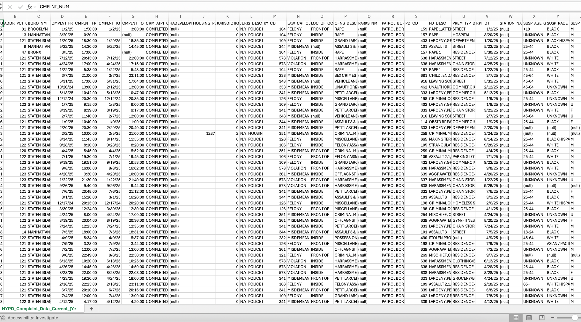
NYC OpenData

Slide 7
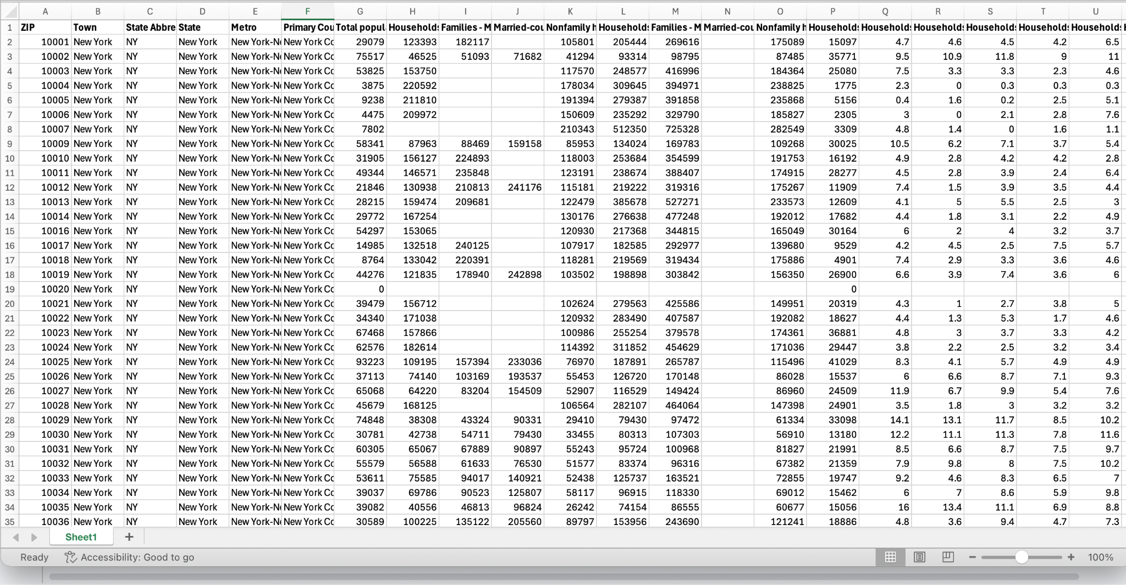
Rowzero

Slide 8
Overall Trends
We analyzed the dataset of all crimes in NYC reported in 2025 to understand what variables are most correlated with the occurrences of crime in NYC. We evaluated:
Where crimes often happen - in certain boroughs? Poor neighborhoods? What type of places?
When they happen - during the night? Certain seasons? Weekdays?
Who is involved - are certain groups of people more likely to commit a crime or be a victim of one?

Slide 9
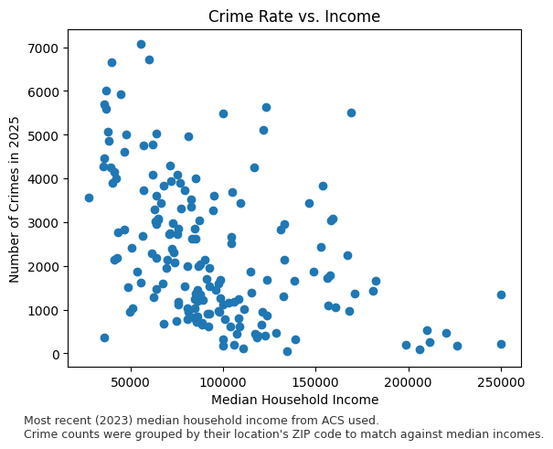
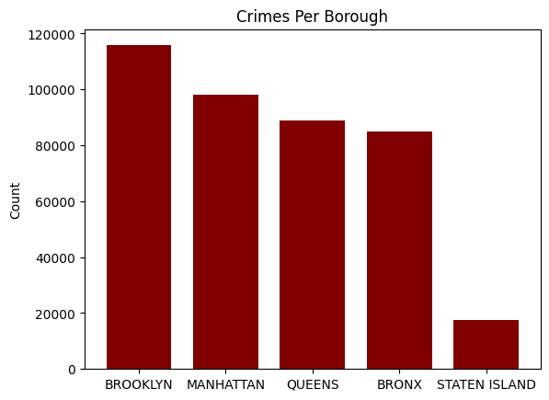
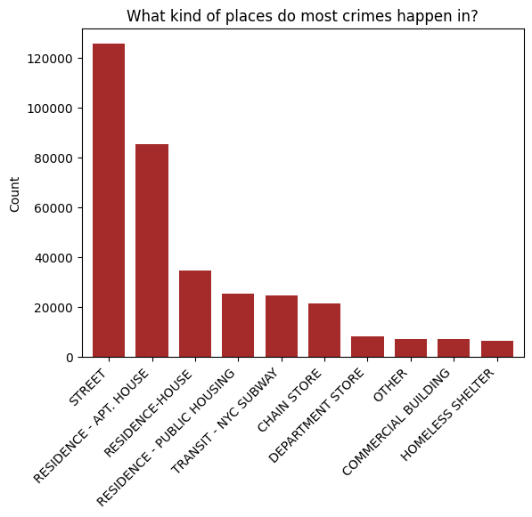
Location-Based Trends
Crimes are concentrated toward areas with lower household incomes.
They typically happen in streets or homes, followed by within the subway system.
Staten Island is overall the safest borough among all 5.
Notes:
Can add a third dimension to crime rate vs income to represent major crime type
Also consider population density for crimes per borough

Slide 10
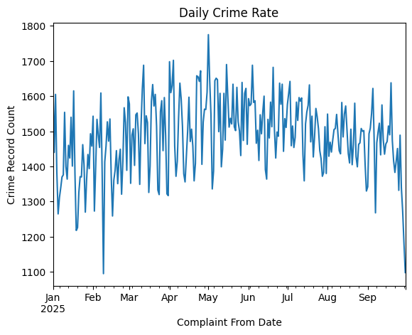
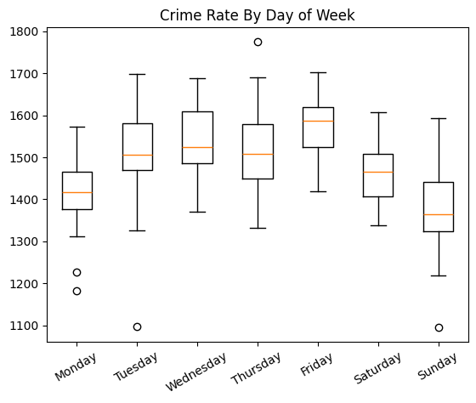
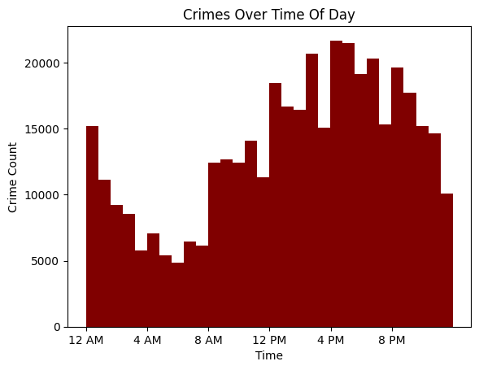
Time-Based Trends

Slide 11
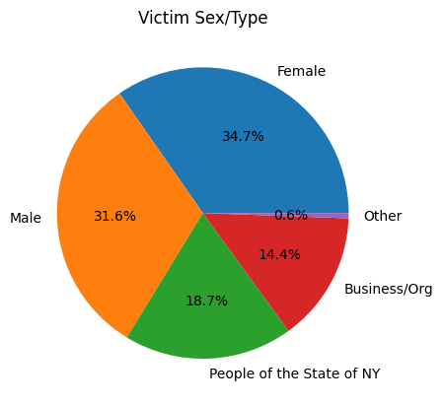
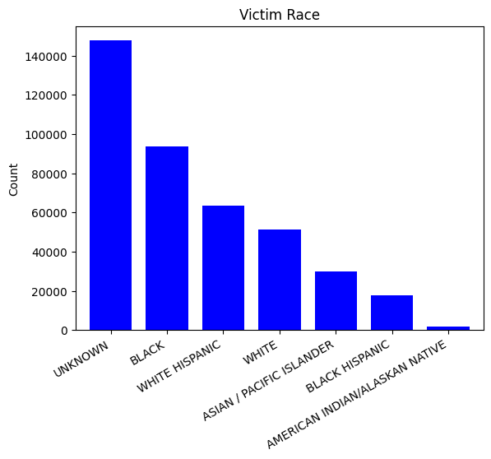
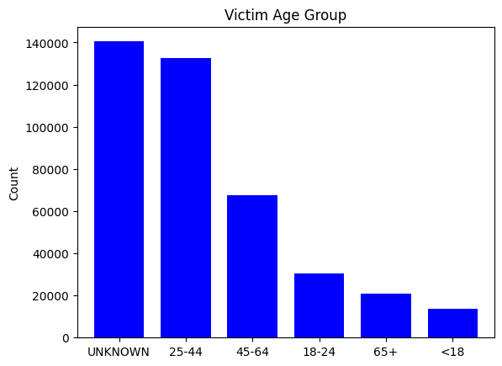
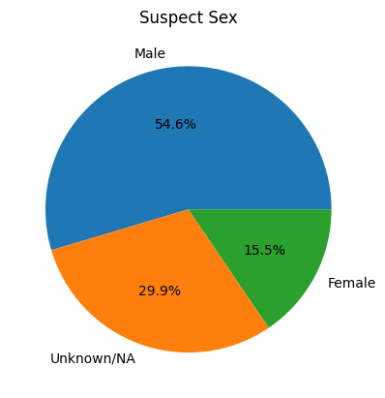
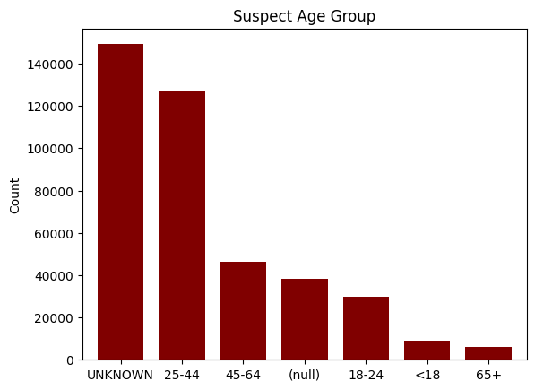
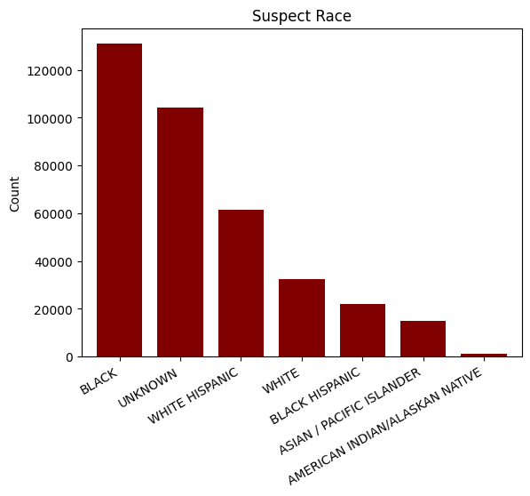

Slide 12
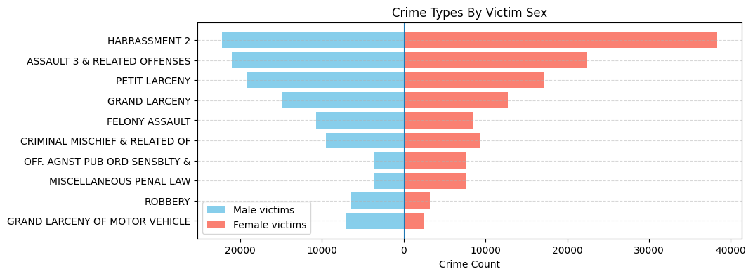
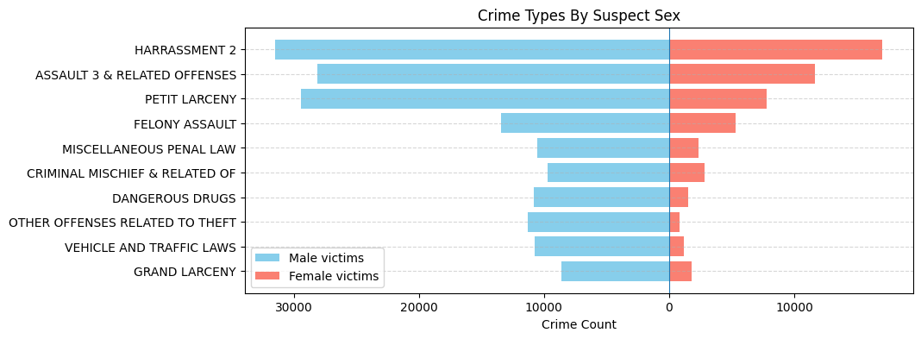
Notes:
Fix negatives in axis

Slide 13
Interactive Map
Uses crime incident data by zip code and median household income.
Crime incident includes:
Zip code
Offense description
Crime type count per zip code
Most common crime per zip code
Total number of crimes per zip code

Slide 14
What it does?
What are we looking at:
Map of all five boroughs
By default displays the top crime per zip code and the crime count
Allows to toggle specific crime types

Slide 15
What does it use?
Pandas for CSV manipulation
GeoPandas to handle geospatial data
Zip code polygon boundaries
reading geographic shapefiles
Uses dataset from NYC MODZCTA GeoJSON (NYC Zip Code Tabulation Areas)
Folium to create the interactive map
Connects python to Leaflet.js which is a Javascript library

Slide 16
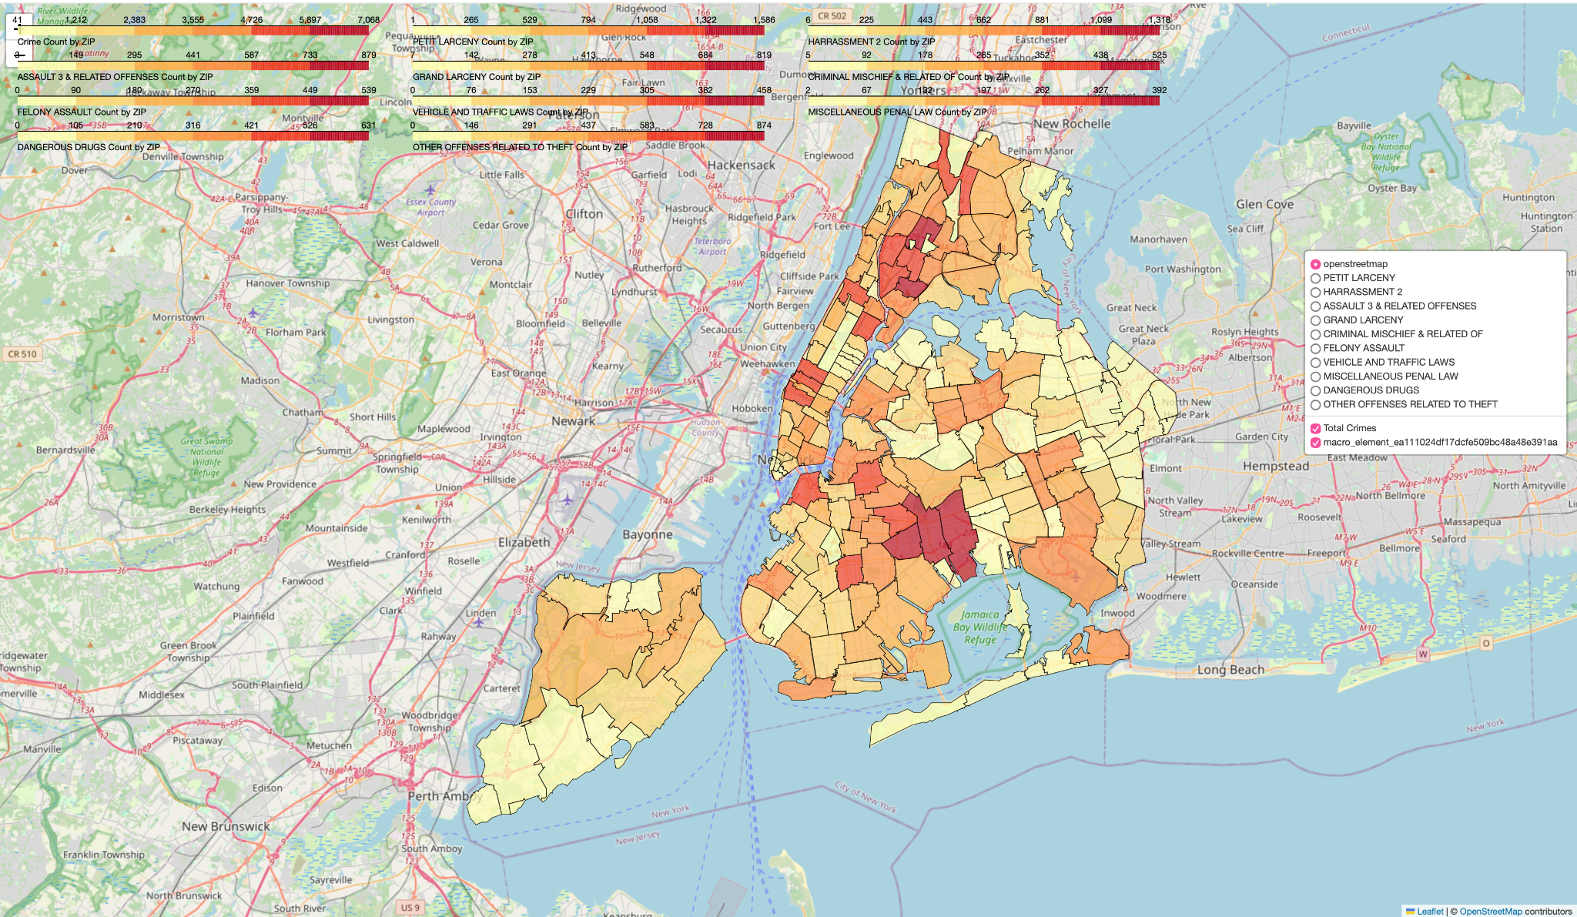
Interactive Map

Slide 17
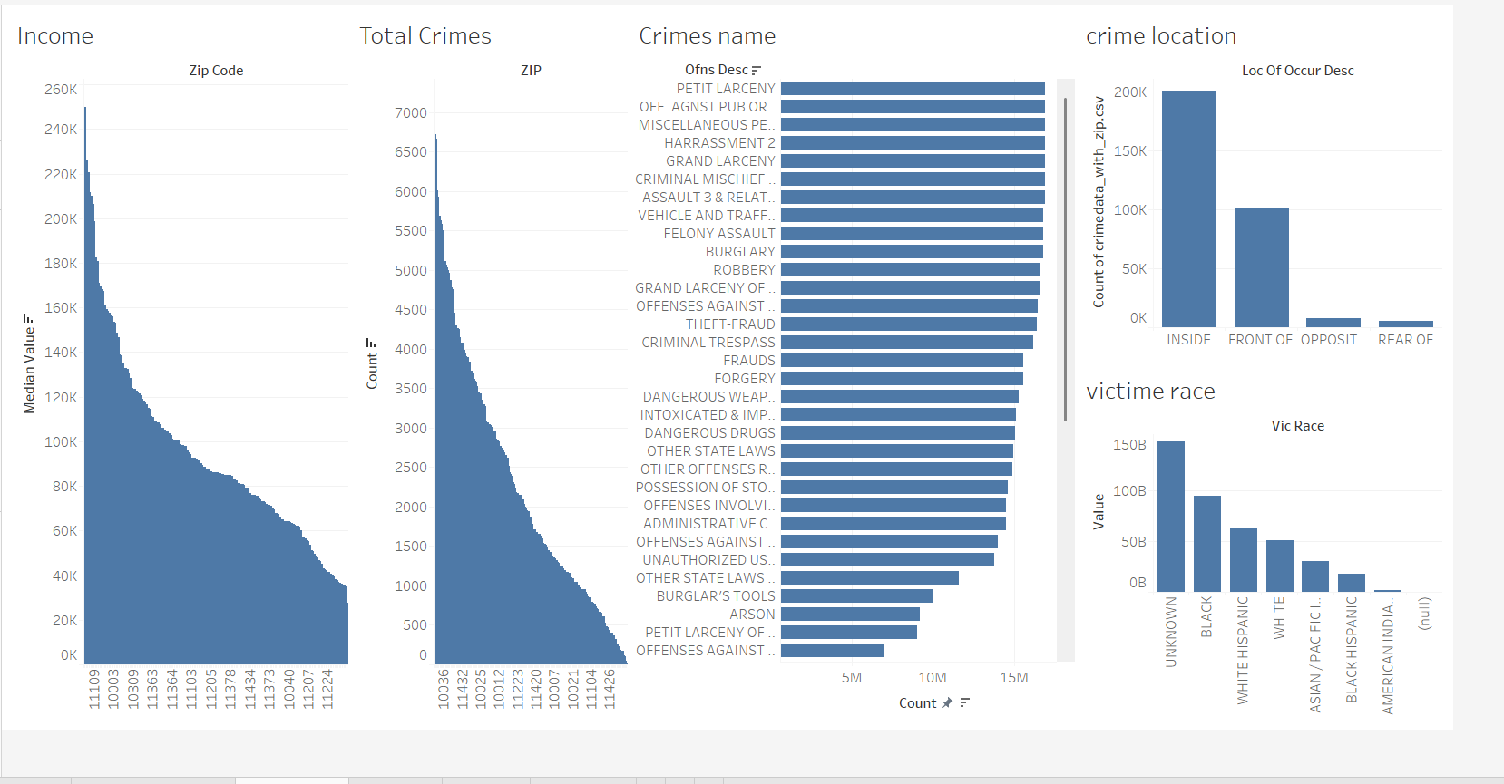
Tableau

Slide 18
Problems We have faced:
Plotting all the individual crime locations will not work
Performance Issues with the Interactive Map
Interaction between graph

Slide 19
Thank you

